Slide 1
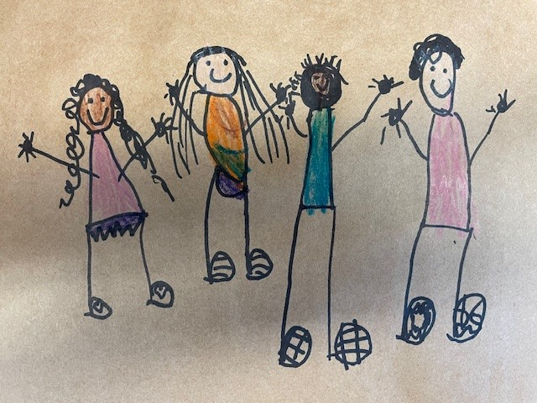

Qualicum School District
Yath ćisum / Always growing / Grandissons ensemble
Early Learning and ChildCare – Fall Update
October 15, 2024

Slide 2
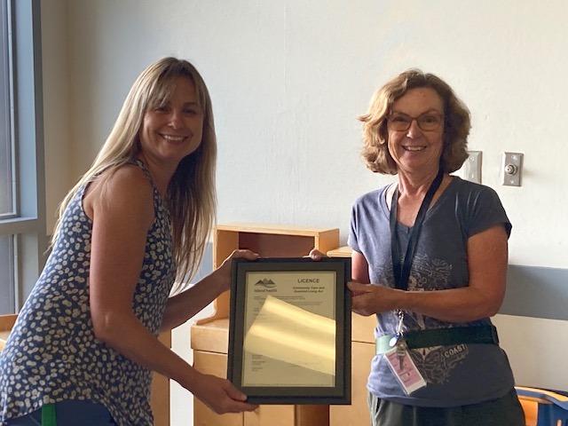
Board Operated After School Care Programs
Errington Elementary Seamless Day (K/1)
  12 Participants
Errington Elementary Program 2 (Gr.2-5)
  19 Participants
Oceanside Elementary (K-5)
  24 Participants (+35 on a waitlist)
Bowser Elementary (K-5)
  12 Participants
  Licensed for Before School Care (need at least 9 participants to open)
Springwood Elementary (K-5)
  24 Participants (+12 on a waitlist)

Slide 3
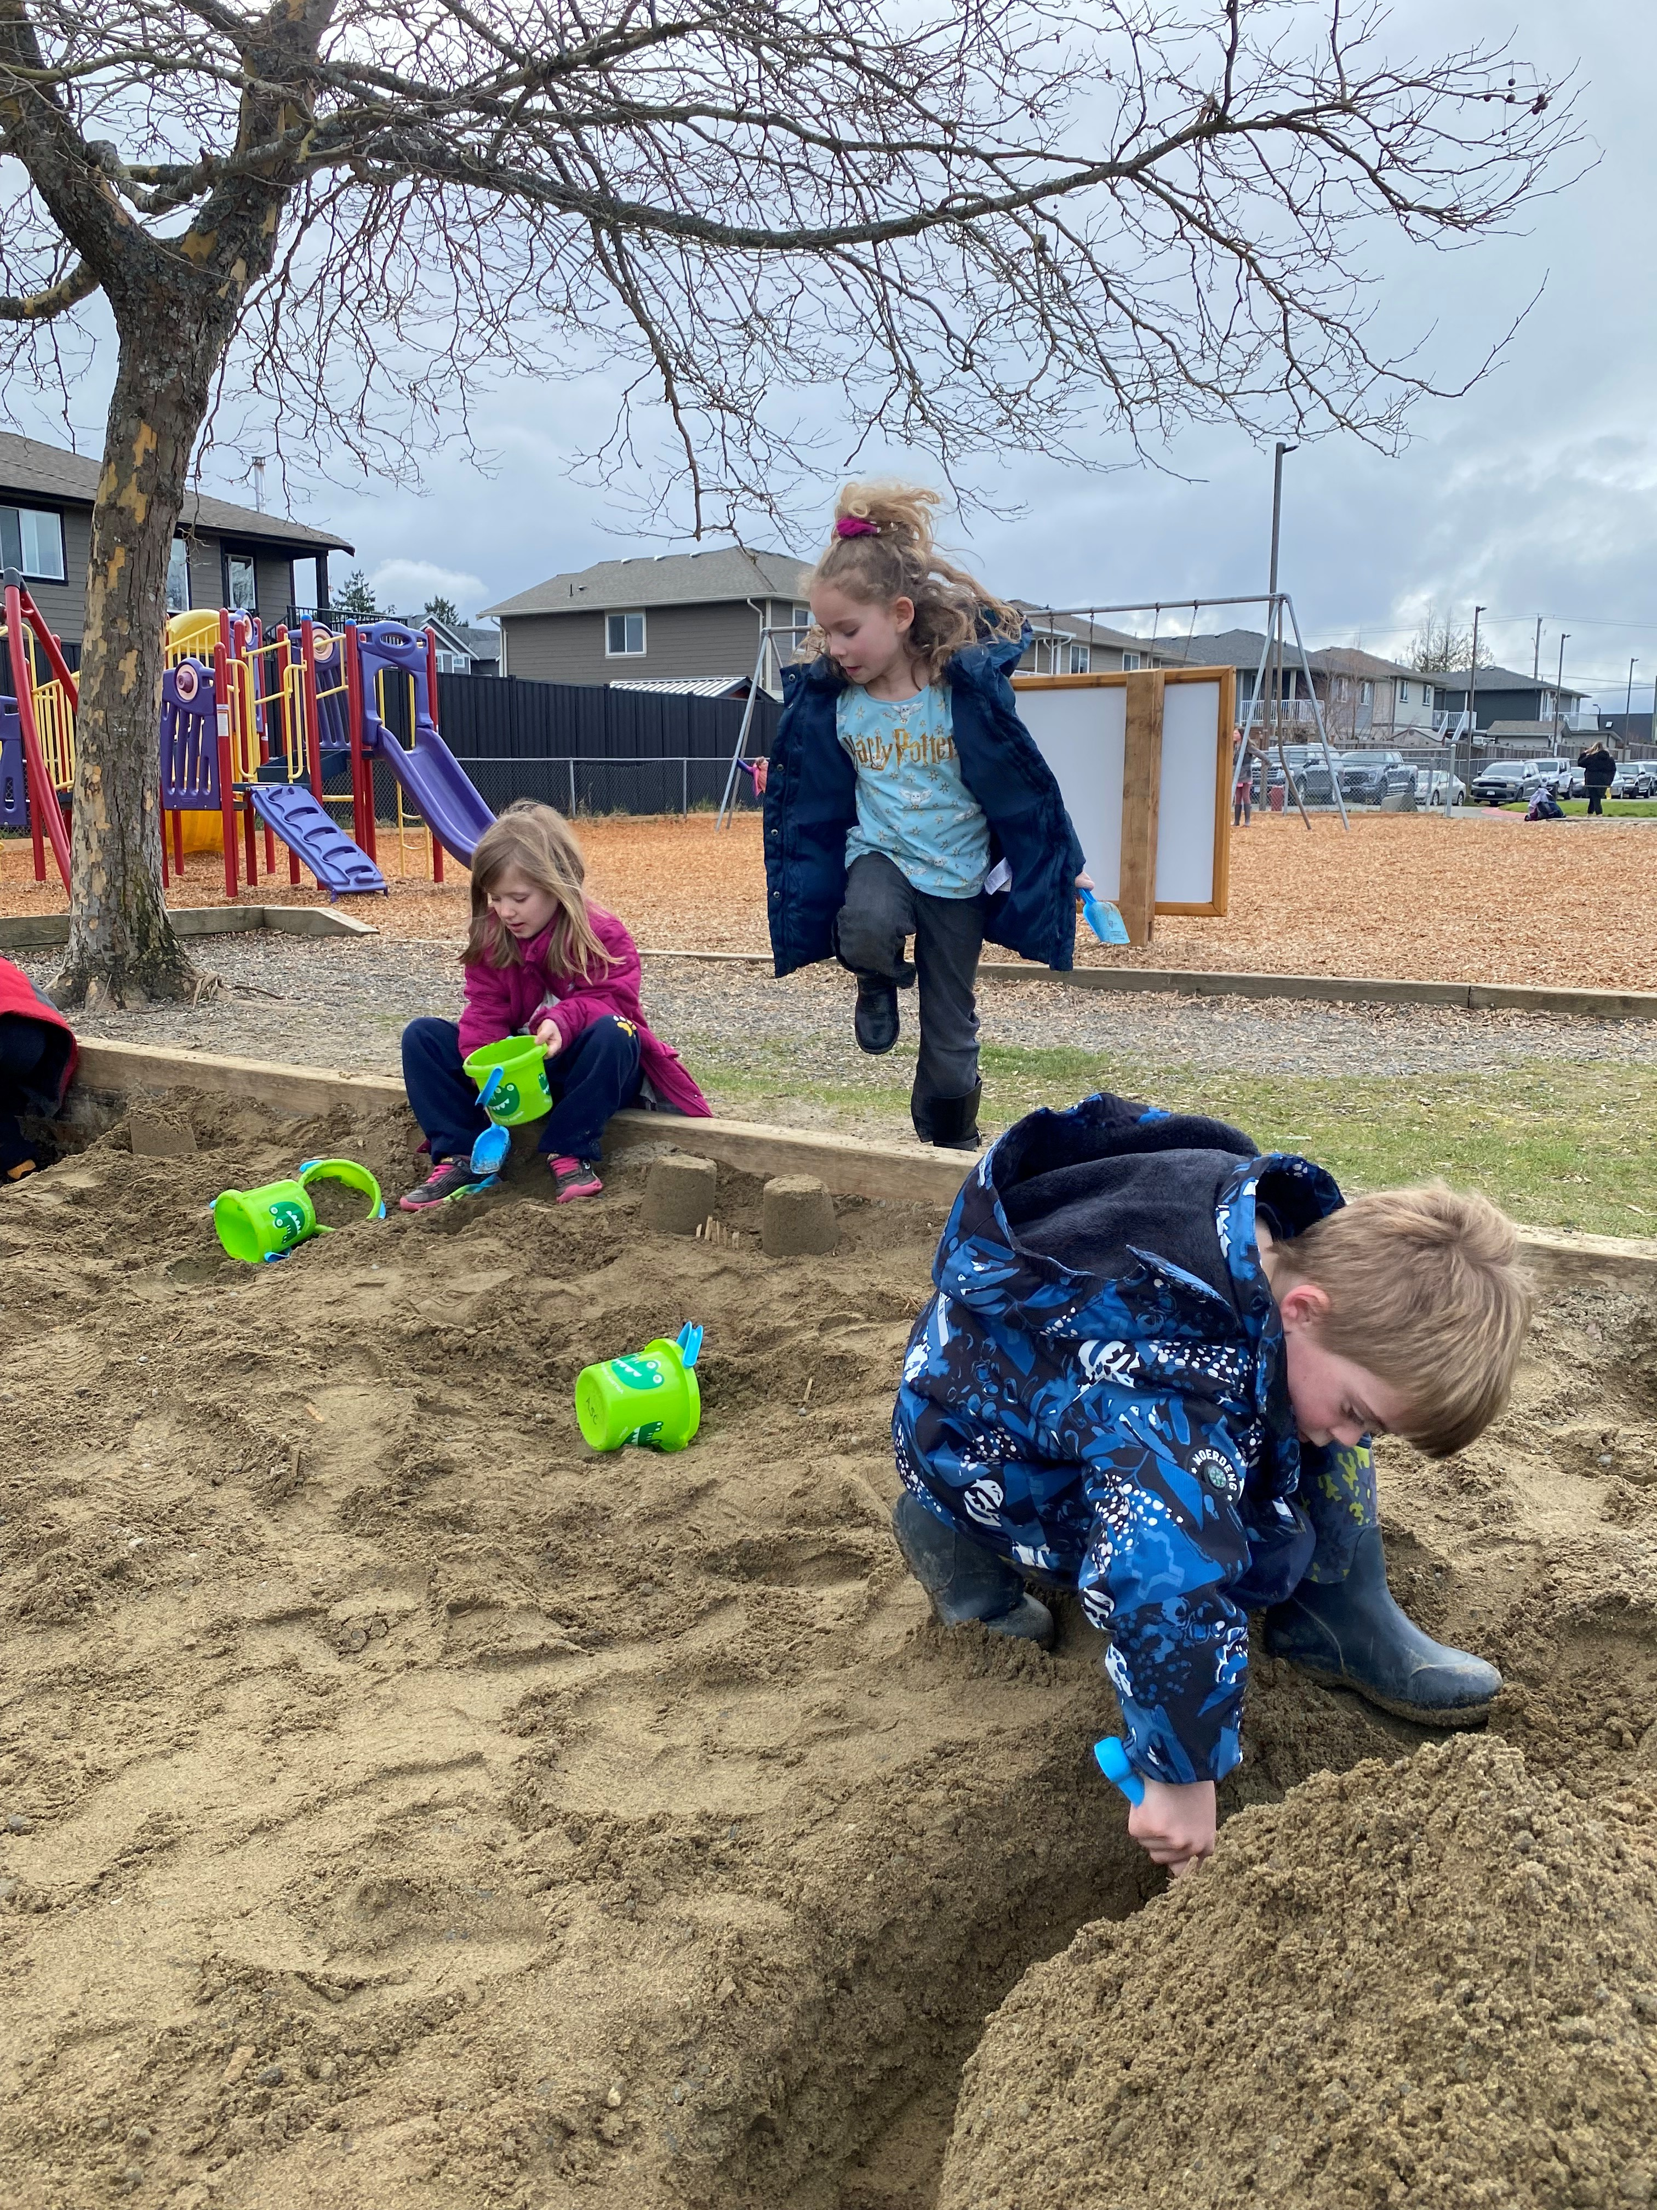
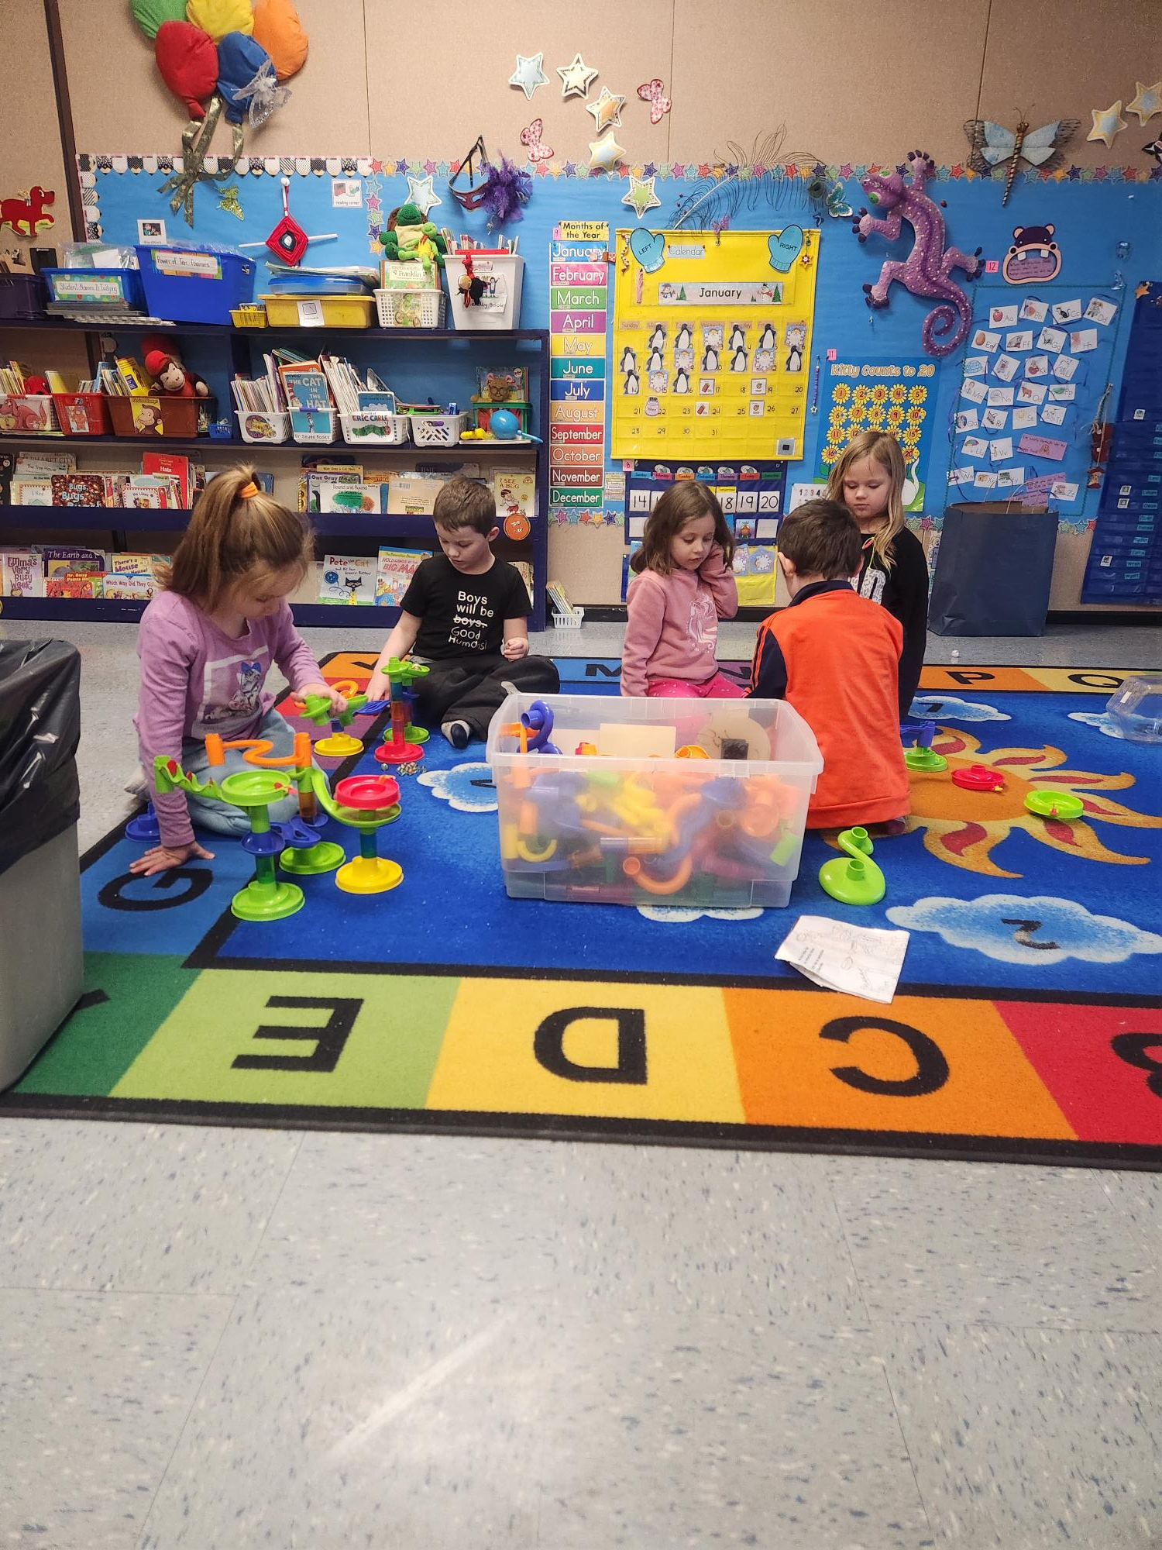
ASC Improvements
Centralized Clerical – registration, invoicing, fees, subsidy
Updated all program binders for consistency
Held orientation for RA staff before starting programs
Resource bins from DRC
Next Steps
Find opportunities to gather RA’s together for professional learning and connection
Develop a checklist for replacement staff
Notes:
Child Care BC Vision
A future where quality and inclusive child care is a core service available to every family that wants it, when they need it, at a price they can afford
After school programs are different from the regular school day as they aren’t related to school curriculum. Our after-school programs are meant to be a safe, nurturing environment that provides for a safe child care outside of the school day. Activities are planned to be preferable and choice based. There is no expectation to provide curricular instruction.
The after-school programs we run are required to follow licensing requirements (Ministry of Health), while providing affordable childcare for school-aged children on school grounds. Prior to starting any program, we go through a rigorous process of applying for licensing. This includes providing floor plans, water testing, fire and other safety protocols, and requiring all staff to have the expected qualifications (RA and/or ECE/ECEA certificates, and first aid training. There are many procedures that need to be followed to be in compliance with licensing, such as student information/record keeping, communication with families, site safety inspections, first aid and incident logs, daily journal, and monthly fire drills. Licensing officers make scheduled and random visits to ensure we are in compliance with licensing requirements.
We have a positive connection with Sources, who provide additional funding for childen who require 1:1 support to be successful in after-school care. This is referred to as “Supportive Childcare”.

Slide 4
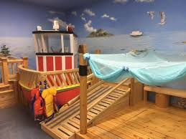
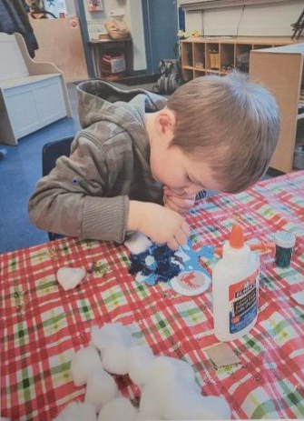
Strongstart Munchkinlands
Notes:
Assumed responsibility for the OBLT in June.

Slide 5
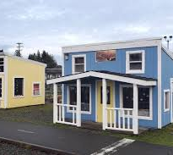
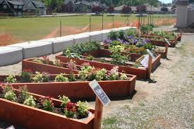
Story Book Village Upgrades

Slide 6
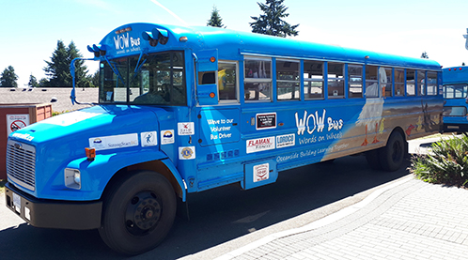
StrongStart Outreach
WOW Bus and Lighthouse Hall

Slide 7
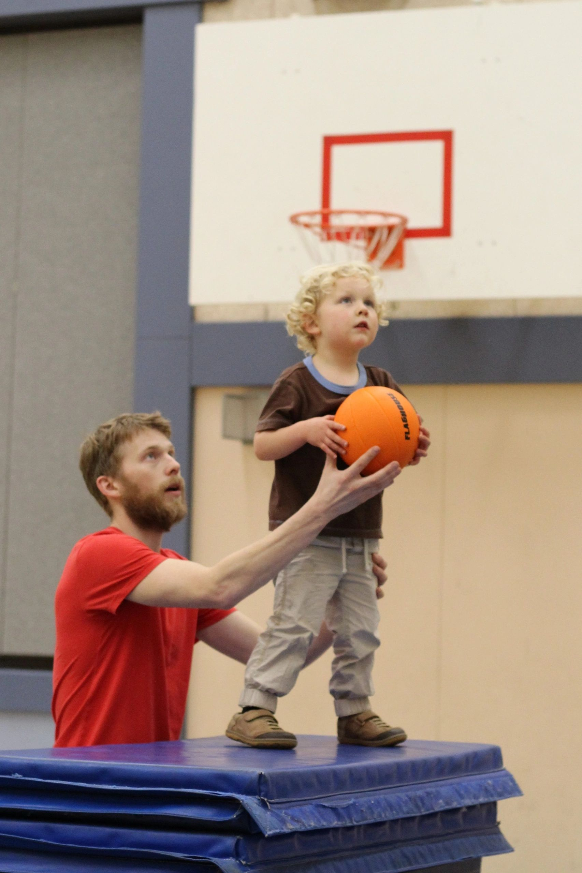
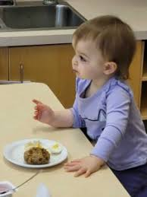
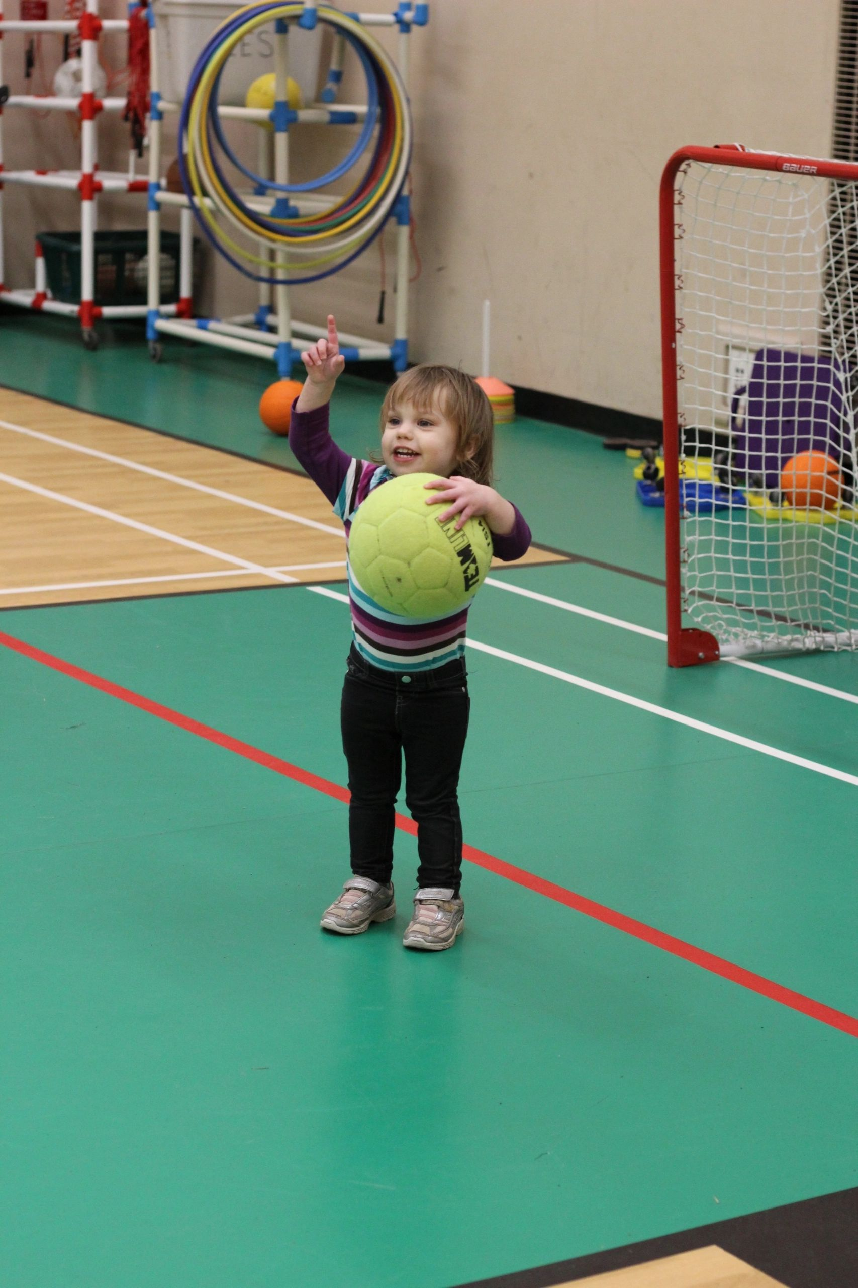
Saturday Breakfast/Family Night Out

Slide 8

Ready, Set, Learn
Free, drop-in, interactive sessions for caregivers and youngsters at local schools
Harnessing the power of play, singing, rhyming, storytelling, and connecting

Slide 9

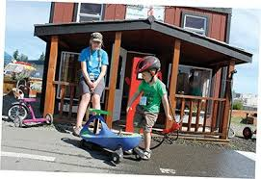
Early Years to Kindergarten
Community
  Munchkinlands
  Storybook Village
  WOW Bus
  Saturday Breakfast Club
  Spooktacular
  Pete the Cat
  Outdoor Days
  Community Partners
School
  Ready, Set, Learn
  Pre-K Program
  Welcome to K
  Individual transition planning
Notes:
Goal is to improve the link and transitions between the early years and school age.

Slide 10
StrongStart Facilitators
ECE – NORTH
Qualicum Beach Munchkinland/Storybook Village
Lighthouse Hall Outreach
WOW Bus when at north Qualicum areas
Ready, Set, Learn activities at Bowser Elementary, Qualicum Beach Elementary, and Arrowview Elementary
Co-plan special events (outdoor days, Pete the Cat, Spooktacular, etc.)
ECE – SOUTH
Parksville/Family Place Munchkinland
Saturday Breakfast Club
WOW Bus when at Errington, Nanoose areas
Ready, Set, Learn activities at Oceanside Elementary, Springwood Elementary, Errington Elementary, and Nanoose Bay Elementary
Co-plan special Events (outdoor days, Pete the Cat, Spooktacular, etc.)
Notes:
Family of schools concept

Slide 13





Early Years Coalition Table

Slide 14
Stay tuned…
Changing Results For Young Children
Kindergarten Snapshot

Slide 15
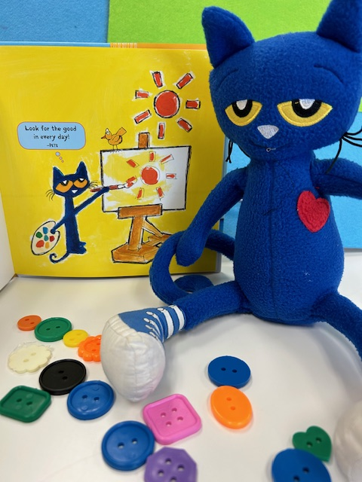

Thank you for supporting our early learners and educators

